Slide 1




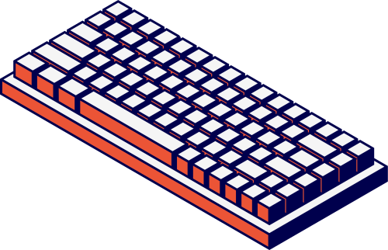
TYPES OF
COMPUTERS
By: Siaton, Charles Andre | BSIT-1

Slide 2
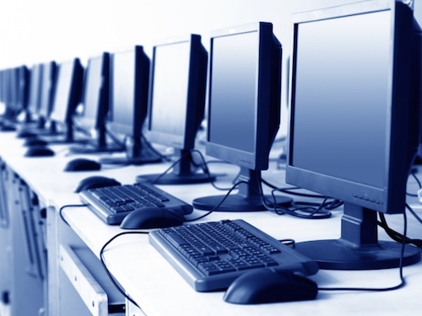
Introduction
This portfolio presents a comparative study on various types of computers, exploring their unique features, capabilities, and suitable applications. It highlights the distinctions among mainframe computers, mini computers, servers, workstations, and microcomputers, providing insights into their processor speeds, memory sizes, energy usage, and common use cases. By understanding these differences, users can make informed choices that align with their specific computing needs, whether it's for high-volume transaction processing or general everyday tasks. Additionally, the portfolio includes detailed examples and specifications for each computer type, ensuring a comprehensive understanding of modern computing technology.

Slide 3
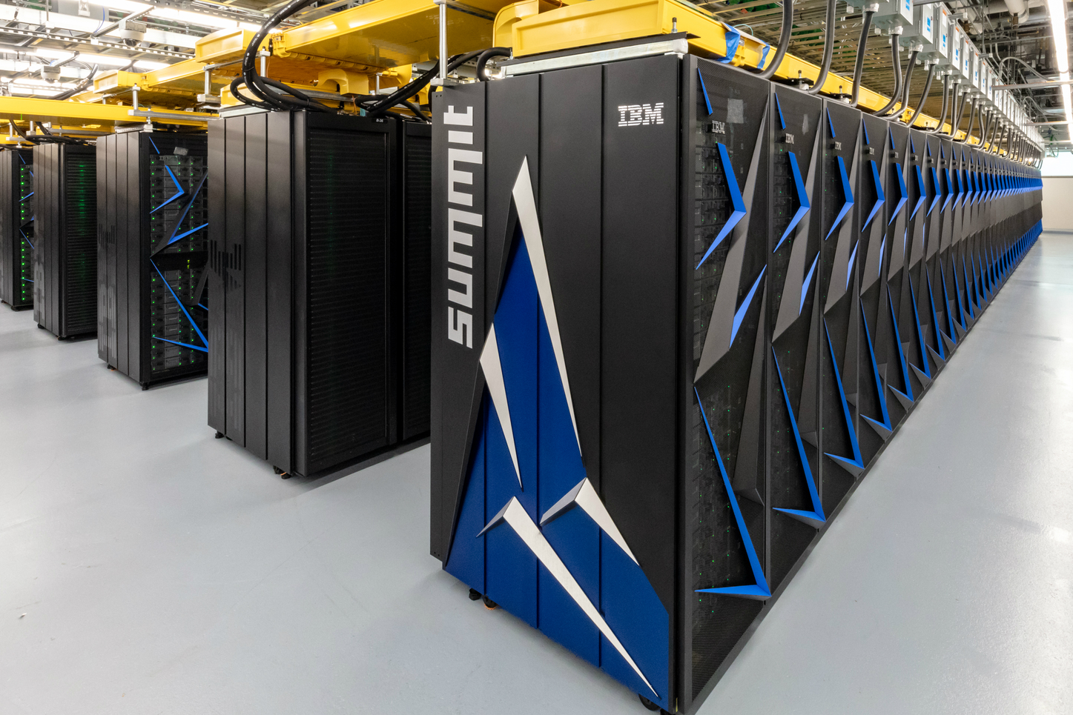
Super Computers
Supercomputers are powerful machines designed for complex calculations at high speeds. They excel in processing vast amounts of data, making them essential for scientific research, weather forecasting, and simulations. Their architecture includes thousands of processors and significant memory capacity, enabling them to handle demanding tasks like climate modeling and molecular simulations.
Example: IBM Summit
Build: High-performance architecture with numerous nodes
CPU: Power9 CPU with up to 3.1 GHz, 22 cores per chip
Memory: 2.4 PB of memory
Processing Speed: 200 petaflops
Usage: Scientific modeling, genomics, climate research, artificial intelligence

Slide 4
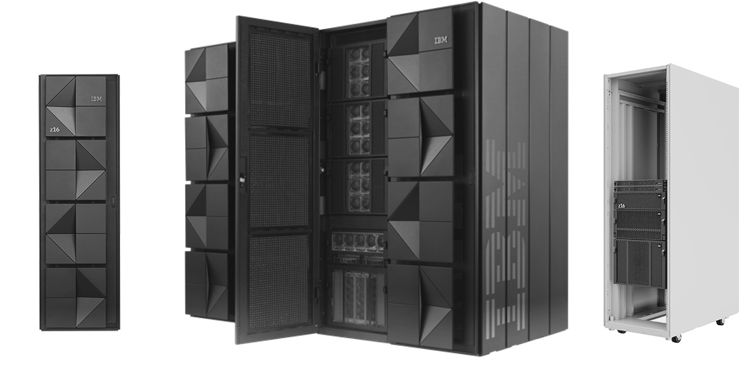
Mainframe Computers
Mainframe computers are designed to manage high transaction volumes, making them essential for industries such as banking. With their robust processing power, they handle large-scale operations effectively, ensuring swift and reliable transaction processing.
Example: IBM z16
Build: 19-inch rack
CPU: Up to 5.2 GHz
Memory: Up to 40 TB RAM
Calculating Power: 2,000 MIPS, enhanced performance for transactions
Usage: Large-scale transaction processing, financial applications, and data analytics

Slide 5
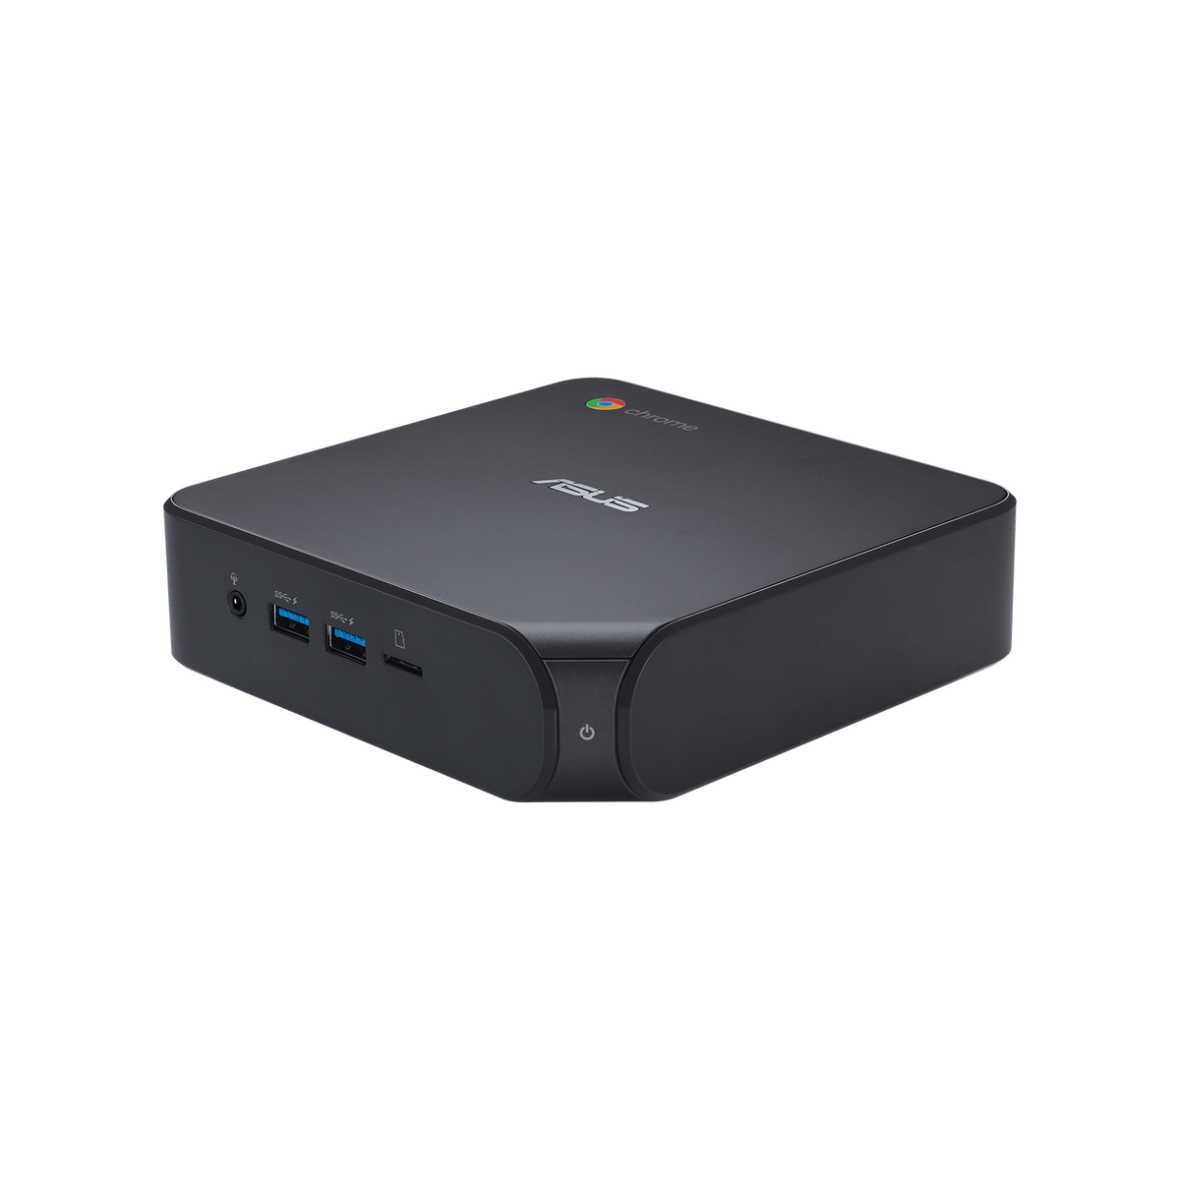
Mini Computers
Mini computers, also known as mid-size computers, are smaller than mainframes but still powerful enough to perform various tasks for business and personal use. They are designed for individual users or small groups, offering a balance between performance and size. These computers are ideal for everyday tasks, such as office work, web browsing, and media streaming.
Example: ASUS ChromeBox 4
Dimensions: 4.4 x 4.4 x 1.9 inches
CPU: Intel Core i7-10510U, up to 4.7 GHz
Memory: Up to 16 GB RAM
Usage: Cloud computing, office work, media streaming, and light gaming.

Slide 6
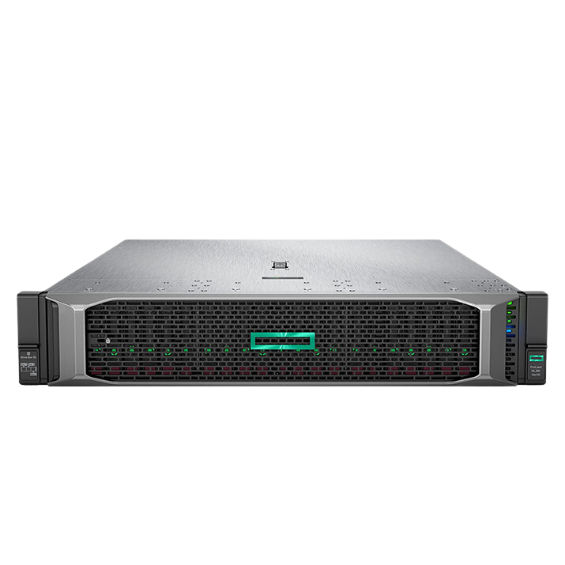
Servers
Servers are specialized computers that manage network resources and provide services to other computers on a network. They are designed to handle multiple requests concurrently, making them essential for web hosting, enterprise applications, and data storage. Servers often operate in data centers and can support many users accessing data and applications simultaneously.
Example: HPE ProLiant DL380 Gen10 Plus
Build: Rack-mounted (2U size)
CPU: Intel Xeon Scalable, up to 3.6 GHz
Memory: Up to 3 TB RAM
Usage: Virtualization, cloud applications, and enterprise applications.

Slide 7
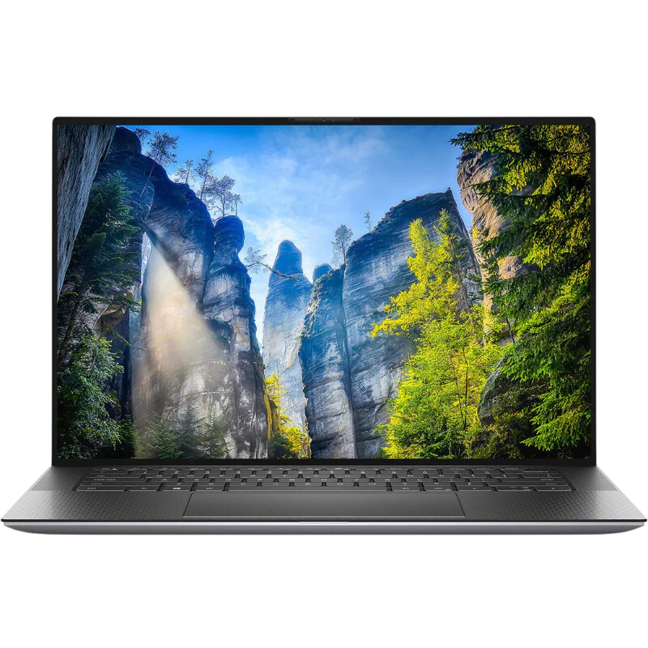
Workstations
Workstations are high-performance computers tailored for technical or engineering applications. They are equipped with powerful processors, substantial memory, and advanced graphics capabilities, making them suitable for tasks like graphic design, video editing, and 3D modeling. Workstations provide enhanced performance for professionals who require intensive computing power for their projects.
Example: Dell Precision 5550
Build: 15.6 inches (thin and light design)
CPU: Intel Core i9-11900H, up to 5.0 GHz
Memory: Up to 64 GB RAM
Usage: Graphic design, 3D rendering, software development, and engineering applications.

Slide 8
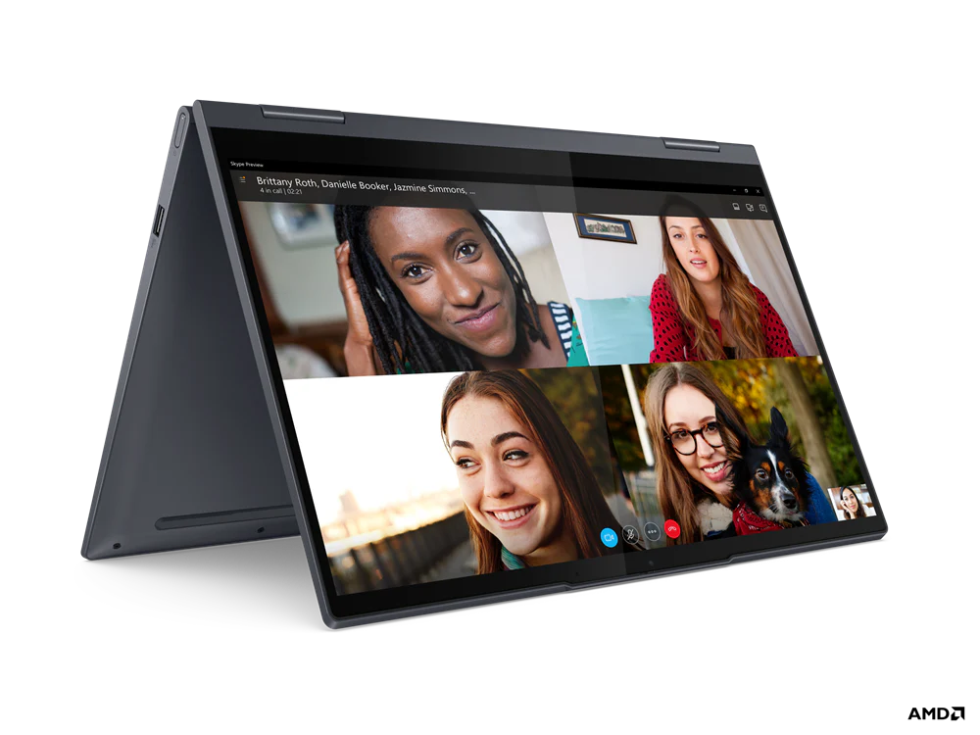
Micro Computers
Microcomputers, commonly referred to as personal computers (PCs), are the most widely used type of computer. They are designed for individual users and are suitable for a variety of tasks, including word processing, web browsing, multimedia consumption, and gaming. Microcomputers come in various forms, including desktops, laptops, and tablets, making them versatile for both personal and professional use.
Example: Lenovo Yoga 7i
Build: 14 inches (convertible laptop)
CPU: Intel Core i5-1135G7, up to 4.2 GHz
Memory: Up to 16 GB RAM
Usage: General computing tasks, web browsing, multimedia, and lightweight gaming.

Slide 9
Comparison
A. Mini Computer
Processing Speed: Moderate
Memory Capacity: Moderate
Power Consumption: Low
Minimum: Low-end tasks
Usage: Office applications, multimedia, casual gaming
B. Micro Computer
Processing Speed: Low to Moderate
Memory Capacity: Low to Moderate
Power Consumption: Very low
Minimum: Basic tasks (like web browsing and email)
Usage: Everyday tasks, home use
C. Workstation
Processing Speed: High
Memory Capacity: High
Power Consumption: Moderate to High
Minimum: Entry-level professional projects
Usage: Professional software applications
D. Server
Processing Speed: Very High
Memory Capacity: Very High
Power Consumption: High
Minimum: Small-scale server duties
Usage: Enterprise-level tasks, data centers, web hosting.

Slide 10
References
IBM. (2024). What is a mainframe? Retrieved from https://www.ibm.com/topics/mainframe
Wikipedia contributors. (2024). Mainframe computer. In Wikipedia, The Free Encyclopedia. Retrieved from https://en.wikipedia.org/wiki/Mainframe_computer
ZDNet. (2024). The best mini PCs of 2024: Expert recommended. Retrieved from https://www.zdnet.com/article/best-mini-pc/
Tom's Guide. (2024). The best mini PCs in 2024 tested and reviewed. Retrieved from https://www.tomsguide.com/us/best-mini-pc.html
ServerWatch. (2023). What is a server? Retrieved from https://www.serverwatch.com/guides/what-is-a-server/
Summit Hosting. (2024). The 3 major server resources: Explained. Retrieved from https://www.summithosting.com/server-resources-explained/
DigitalOcean. (2024). What is a server? Retrieved from https://www.digitalocean.com/community/tutorials/what-is-a-server
SoftwareLab. (2024). What is a server? Everything you need to know. Retrieved from https://softwarelab.org/blog/what-is-a-server/
TechRadar. (2024). Best mini PC of 2024: Top picks for every budget. Retrieved from https://www.techradar.com/best/mini-pcs
mvix.com. (2024). A deep dive into the components of mini PCs. Retrieved from https://mvix.com/blog/mini-pc-components/
Parmar, D. (2024, July 4). Top 12 mini computers for portability and performance. Geekflare. Retrieved from https://geekflare.com/consumer-tech/top-mini-computers/?form=MG0AV3
Bitner, J., Brookes, T., & Damnjanovic, G. (2024, September 2). The best mini PCs of 2024. How-To Geek.

Slide 11
Thanks
For your attention!

